Slide 1
SUPERMARKET INVENTORY AND SALES MANAGEMENT system
Presented BY
Sarin alexander
Sufail khalid pkc
Adarsh kv
Minto mohan

Slide 2
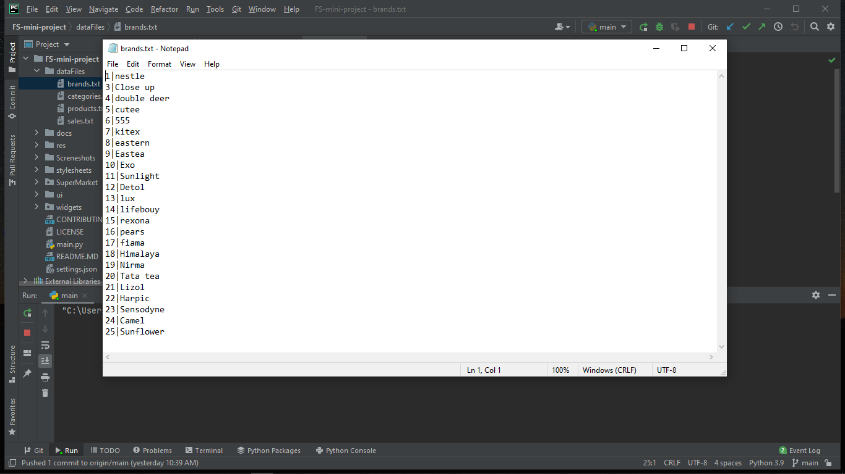
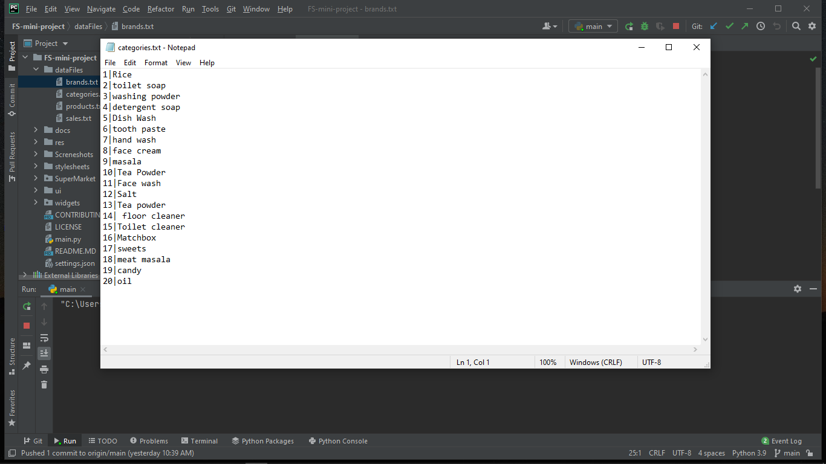
Brands File
Categories File
Brand ID
Brand Name
Category Name
Category ID

Slide 3
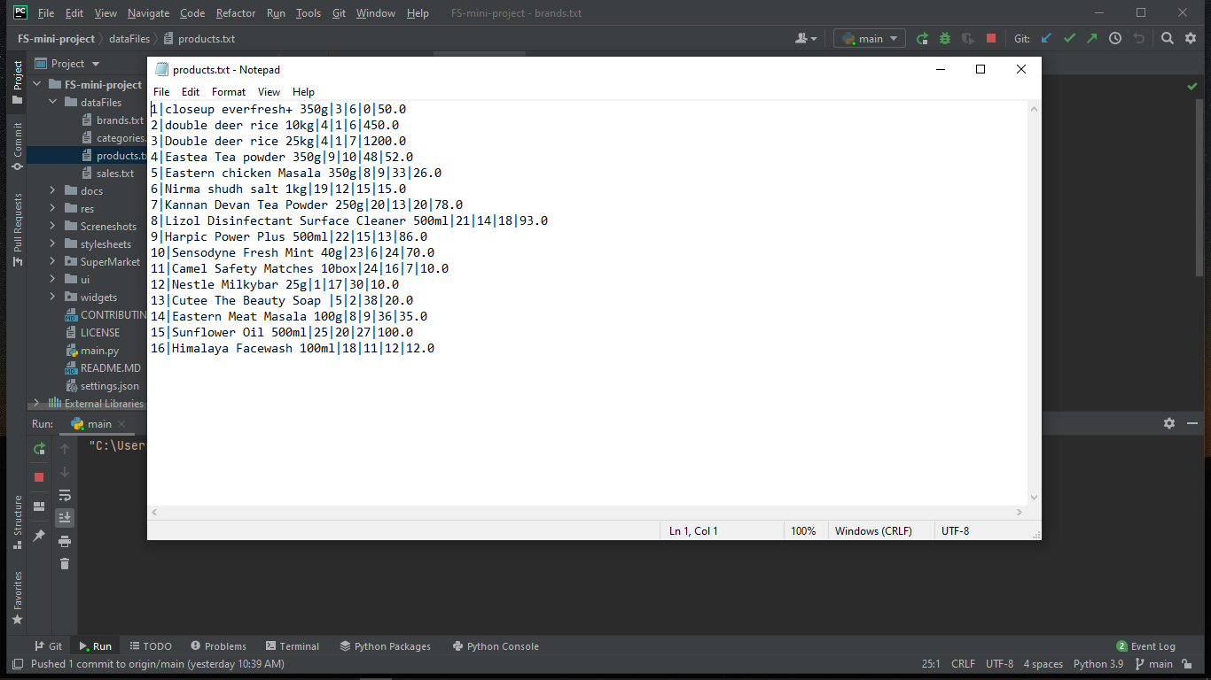
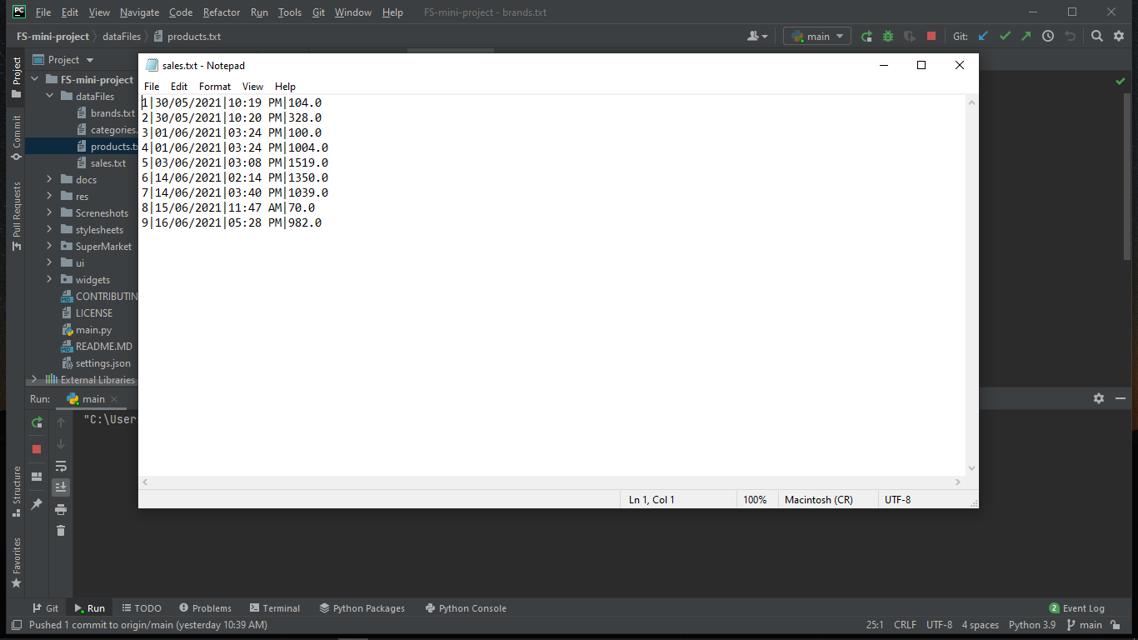
Products File
Sales File
Stock
Product ID
Product Name
Prize
Date
Time
Amount
Category ID
Sale ID
Brand ID

Slide 4
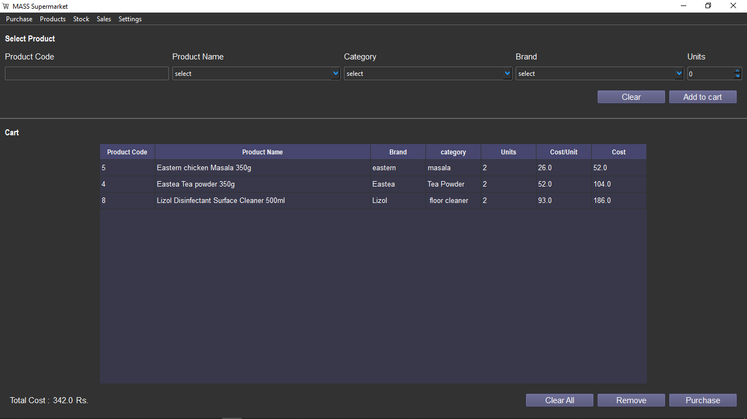
Purchase Page

Slide 5
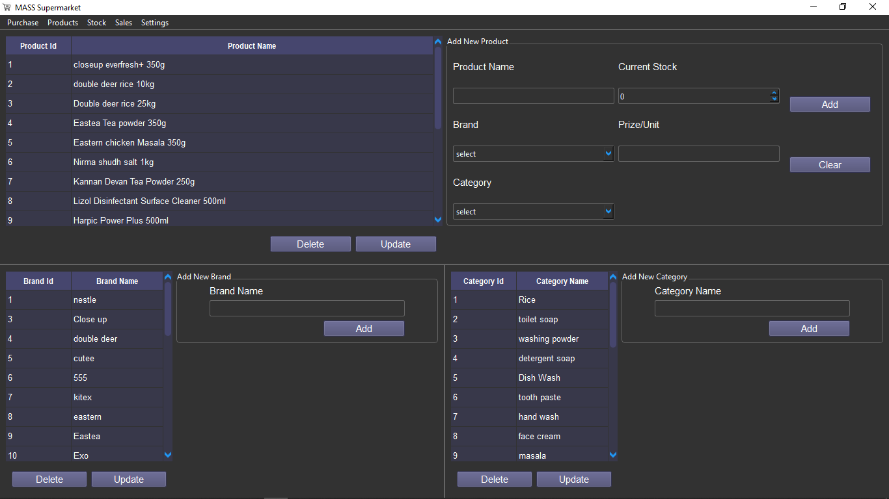
Products Page

Slide 6
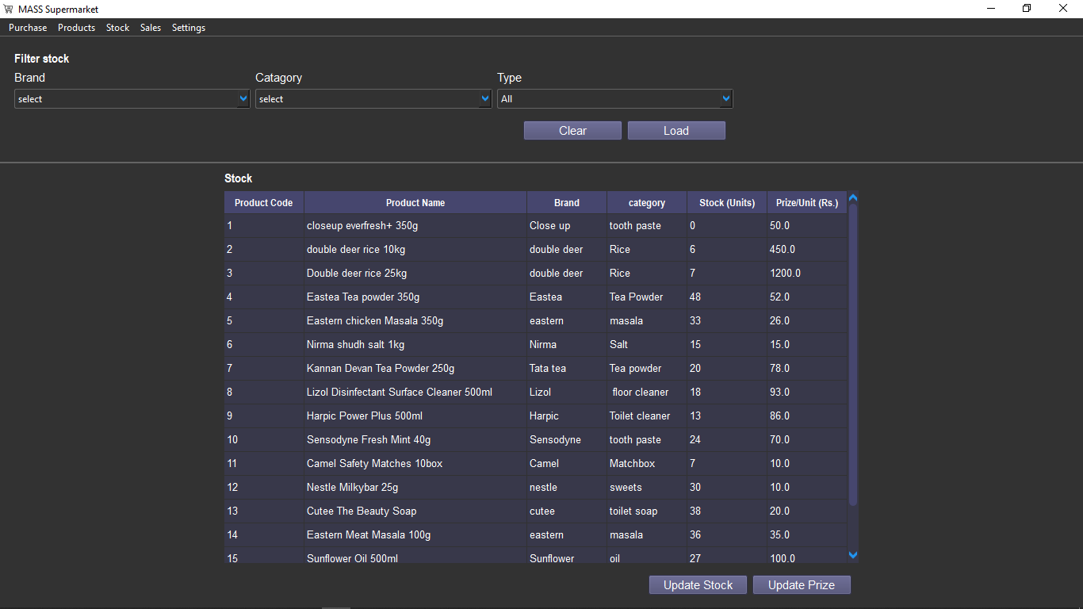
Stock Page

Slide 7
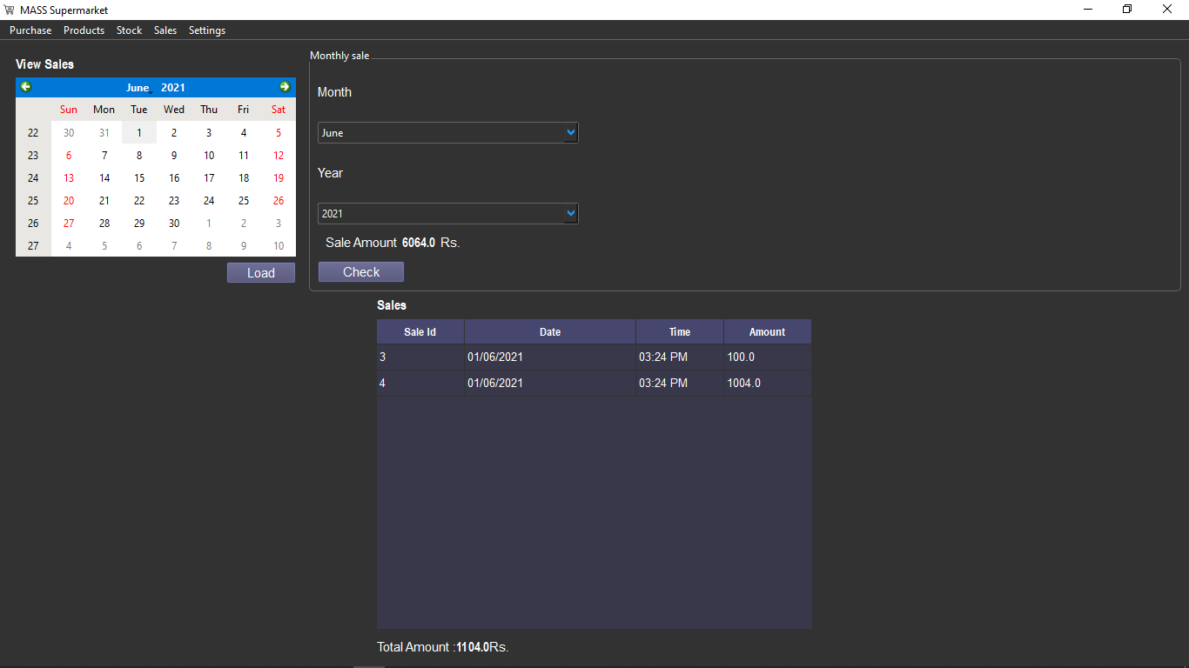
Sales Page

